Slide 1
Command Line GRIB File Exploration and Handling

Slide 2


What is a GRIB file?
“General Regularly distributed Information in Binary form”
WMO standard format for archiving and exchanging gridded data
Binary format; data is packed to increase storage efficiency
Collection of standalone data messages
Coding standards:
GRIB edition 1 (GRIB1)
GRIB edition 2 (GRIB2)
GRIB
message 1
GRIB
message 2
GRIB
message 3
⋯
GRIB
file
GRIB
message n
Reference: What are GRIB files and how I can read them
Notes:
<a href="https://www.flaticon.com/free-icons/email" title="email icons">Email icons created by Freepik - Flaticon</a>
<a href="https://www.flaticon.com/free-icons/folder" title="folder icons">Folder icons created by Freepik - Flaticon</a>

Slide 3
What is a GRIB file?
GRIB
message 1
each GRIB message in a GRIB file is standalone, i.e. metadata+data
can be a combination of different GRIB editions
typically, one message for a specific variable at a specific level, valid at a specific time
sample of metadata:
grid, projection, variable name, units…
GRIB
message 2
GRIB
message 3
⋯
GRIB
file
GRIB
message n
Reference: What are GRIB files and how I can read them
Notes:
<a href="https://www.flaticon.com/free-icons/email" title="email icons">Email icons created by Freepik - Flaticon</a>
<a href="https://www.flaticon.com/free-icons/folder" title="folder icons">Folder icons created by Freepik - Flaticon</a>

Slide 4
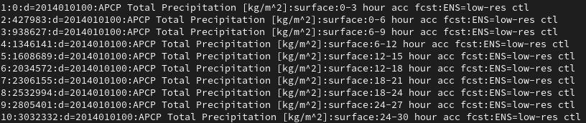
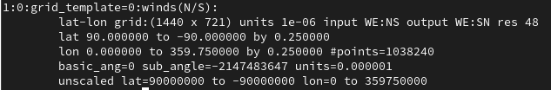
GRIB Message
each GRIB message in a GRIB file is standalone, i.e. metadata+data
typically, one message for a specific variable at a specific level, valid at a specific time
sample of metadata:
grid, projection, variable name, units…
example list of GRIB messages in a file
example grid data of GRIB message 1
Notes:
<a href="https://www.flaticon.com/free-icons/email" title="email icons">Email icons created by Freepik - Flaticon</a>

Slide 5
GRIB1 Message
Section Number | Name | Contents
0 | Indicator section | "GRIB", length of message, GRIB edition number
1 | Product definition section | Length of section, identification of the coded analysis or forecast
2 | Grid description section (optional) | Length of section, grid geometry, as necessary
3 | Bit-map section (optional) | Length of section; the bit per grid point, placed in suitable sequence, indicates omission (bit 0) or inclusion (bit 1) of data at respective points
4 | Binary data section | Length of section and data values
5 | End section | 7777
GRIB is the name of the binary code for the exchange of processed data.
The GRIB coded analysis or forecast consists of a continuous bit-stream made of a sequence of octets (1 octet = 8 bits).
The octets of a GRIB message are grouped in sections (see table)
Although the Grid description section is indicated as optional, it is strongly urged that it be included in all GRIB messages.
It will be noted that the GRIB code is not suitable for visual data recognition without computer interpretation.
The representation of data by means of series of bits is independent of any particular machine representation.
Message and section lengths are expressed in octets. Section 0 has a fixed length of 8 octets; Section 5 has a fixed length of 4 octets. Sections 1, 2, 3 and 4 have a variable length which is included in the first three octets of each section.
In the GRIB message, the bit length of "International Alphabet No. 5" is regarded as 8-bit, adding one bit "0" to the 7-bit of IA5 as the most significant bit.
sections of GRIB1 message
Notes:
https://codes.ecmwf.int/grib/format/grib1/overview/

Slide 6


How to know what messages are inside a GRIB file?
Notes:
<a href="https://www.flaticon.com/free-icons/email" title="email icons">Email icons created by Freepik - Flaticon</a>
<a href="https://www.flaticon.com/free-icons/query" title="query icons">Query icons created by Freepik - Flaticon</a>
<a href="https://www.flaticon.com/free-icons/database" title="database icons">Database icons created by Freepik - Flaticon</a>

Slide 7
wgrib

Slide 8
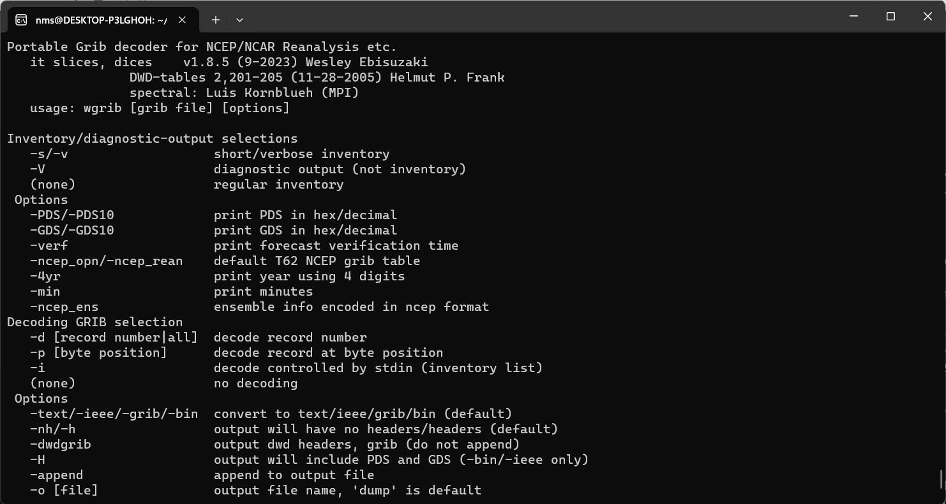
wgrib
“WGRIB is a program to manipulate, inventory and decode GRIB files”
developed by NCEP
can handle both GRIB1 and GRIB2 messages

Slide 9
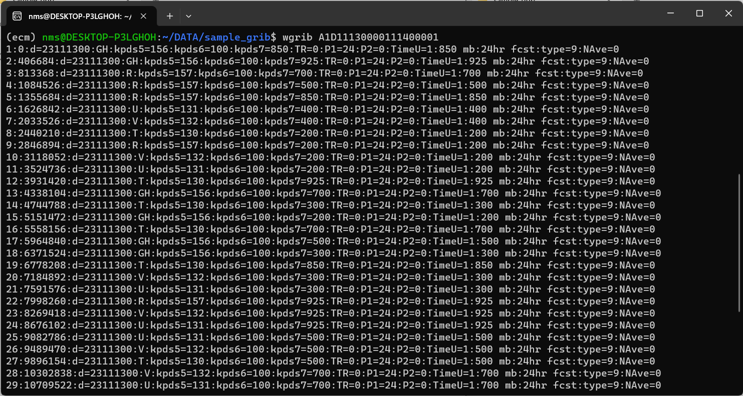
wgrib <file_name>
Standard Inventory

Slide 10
wgrib <file_name>
Standard Inventory
inventory contains several fields separated by colons ( : )

Slide 11
wgrib <file_name>
Standard Inventory
1 Record/message number
2 Position in bytes
3 Reference/initial date (yymmddHH)
4 Parameter name

Slide 12
wgrib <file_name>
Standard Inventory
Product Definition Section (PDS)
5 Indicator of parameter (grib PDS octet 9)
6 Indicator of type of level (grib PDS octet 10)
7 Height, pressure, etc. of levels (grib PDS octets 11-12)

Slide 13
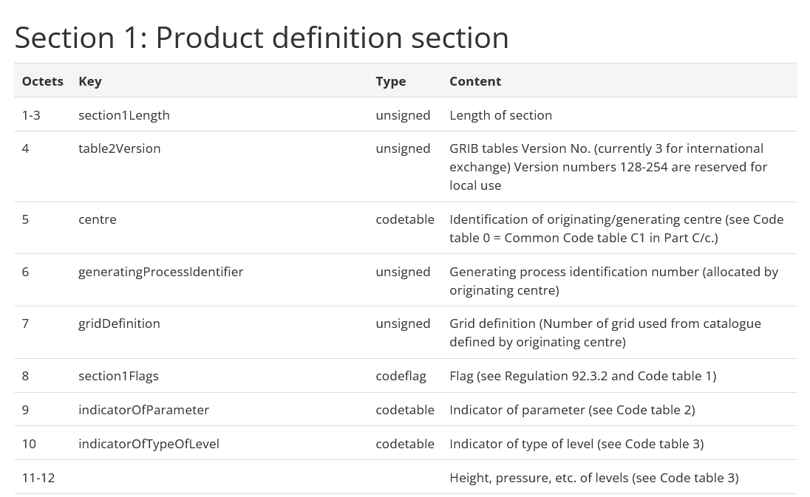
ECMWF GRIB1 PDS

Slide 14
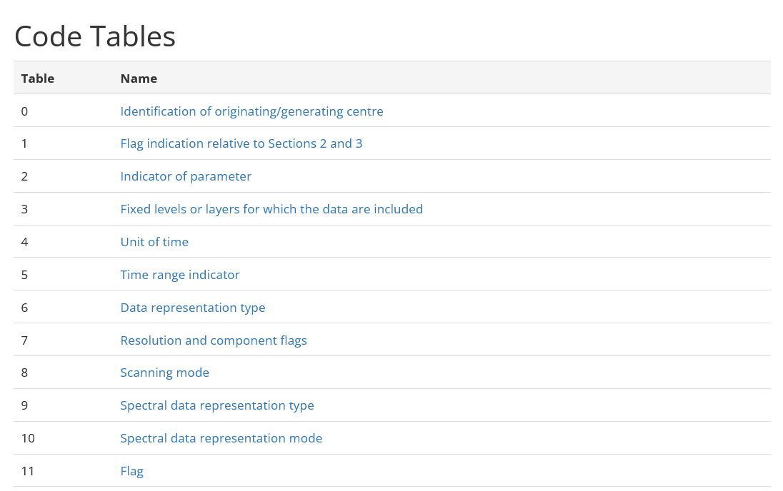
ECMWF GRIB1 Code Tables

Slide 15
wgrib <file_name>
Standard Inventory
Product Definition Section (PDS)
5 Indicator of parameter Code Table 2
6 Indicator of type of level Code Table 3
7 Height, pressure, etc. of levels

Slide 16
wgrib <file_name>
Standard Inventory
8 Time Range (grib PDS octet 21)
9 Period of time 1 (grib PDS octet 19)
10 Period of time 2 (grib PDS octet 20)
11 Forecast time unit (grib PDS octet 18)

Slide 17
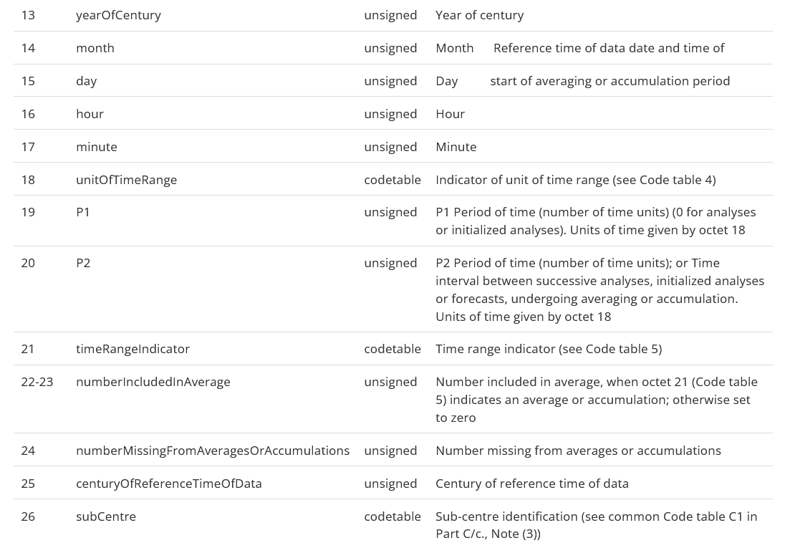
ECMWF GRIB1 PDS

Slide 18
wgrib <file_name>
Standard Inventory
8 Time Range Code Table 5
9 Period of time 1
10 Period of time 2
11 Forecast time unit Code Table 4

Slide 19
wgrib <file_name>
Standard Inventory
12 level
13 anl=analysis, fcst=forecast
14
15 NAve (number of grids used to make average)

Slide 20
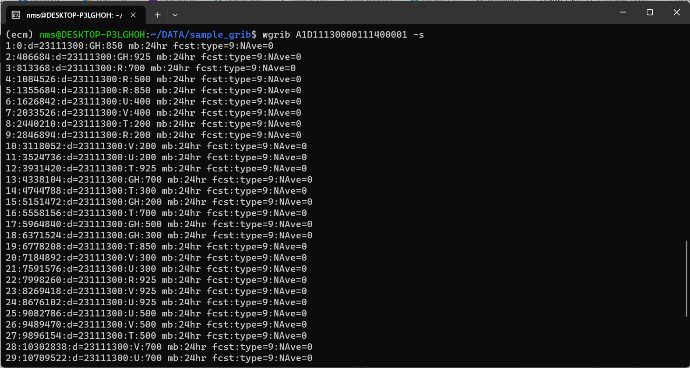
wgrib -s <file_name>
Short Inventory

Slide 21
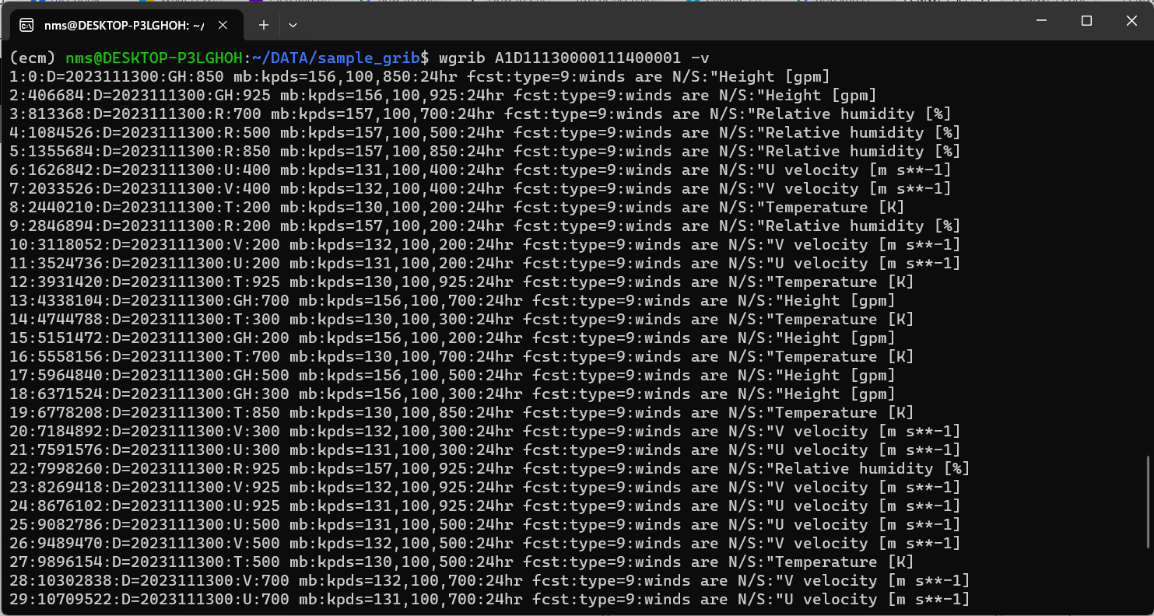
wgrib -v <file_name>
Verbose Inventory

Slide 22
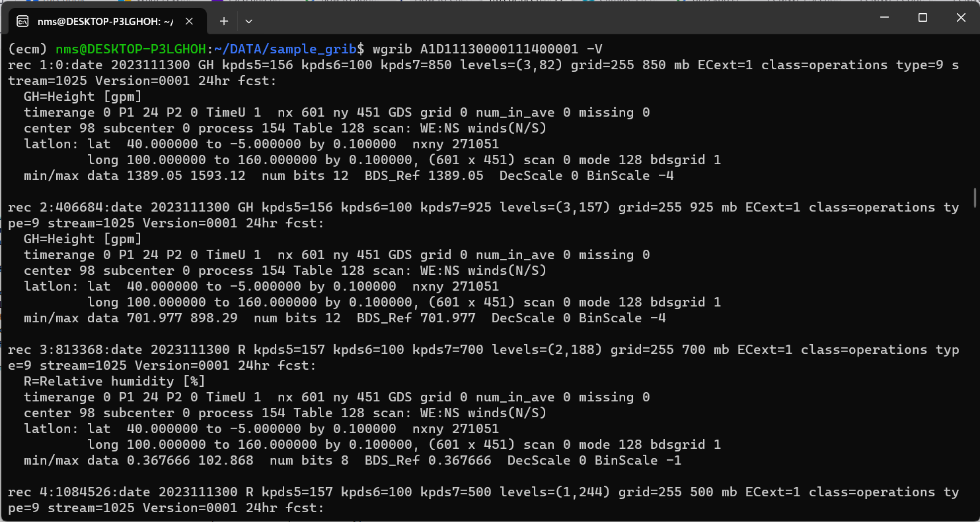
wgrib -V <file_name>
Verbose Description
NOTE that this command will generate a “dump” file

Slide 23
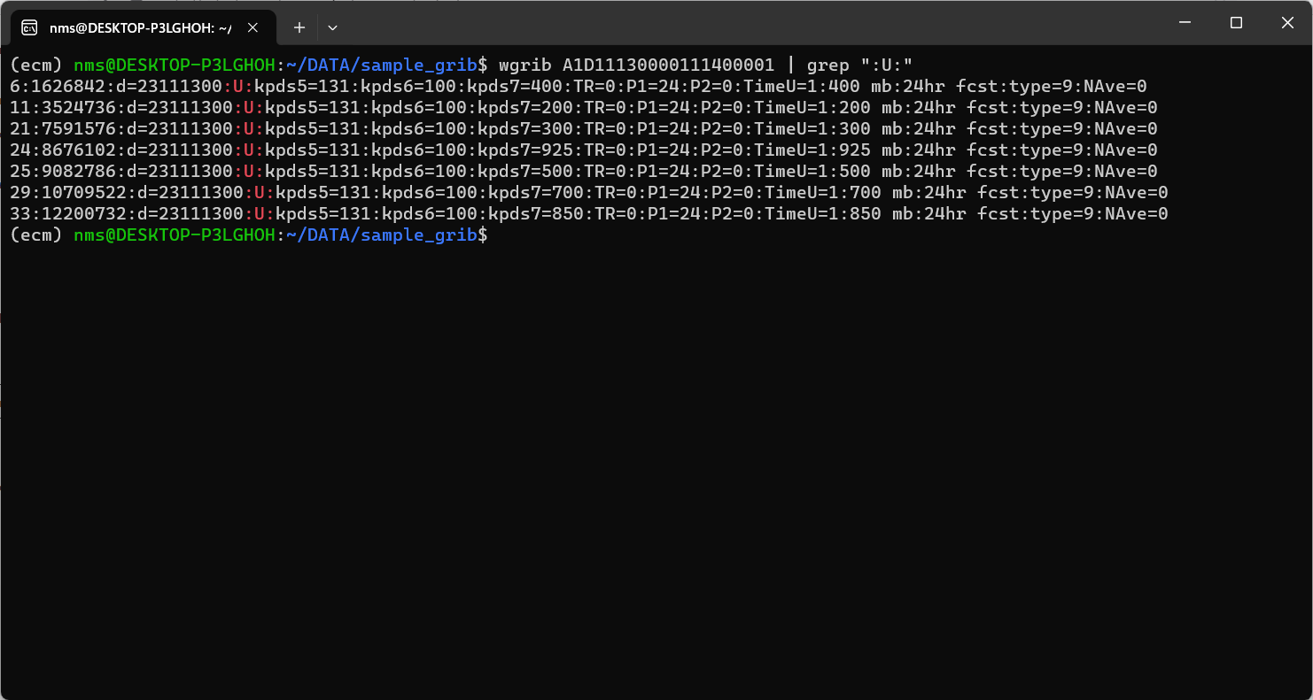
wgrib
Data selection by parameter name

Slide 24
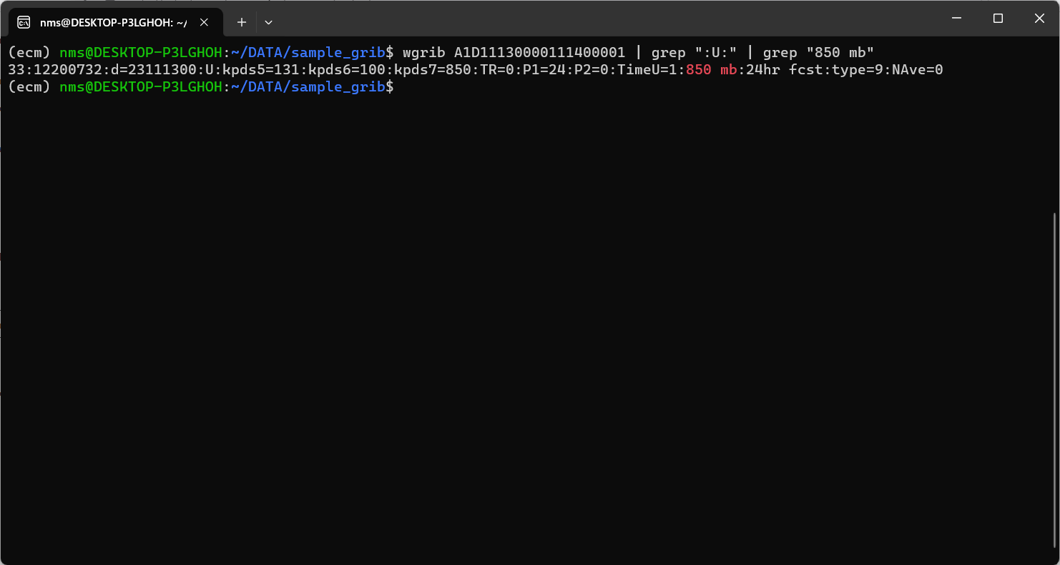
wgrib
Data selection by parameter name and specific level

Slide 25
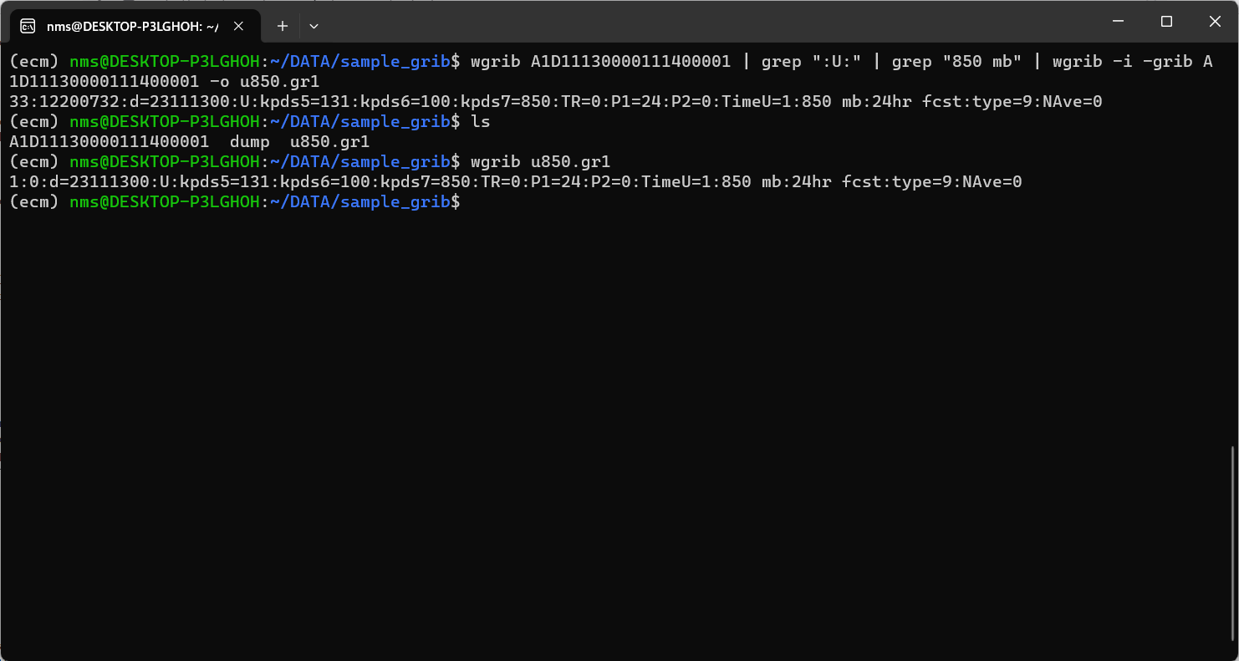
wgrib
Data selection then save as another grib file

Slide 26
ecCodes

Slide 27
ecCodes
ecCodes is a package developed by ECMWF which provides an application programming interface and a set of tools for decoding and encoding messages in the following formats:
WMO FM-92 GRIB edition 1 and edition 2
WMO FM-94 BUFR edition 3 and edition 4
WMO GTS abbreviated header (only decoding).
A useful set of command line tools provide quick access to the messages.
C, Fortran 90 and Python interfaces provide access to the main ecCodes functionality.

Slide 28
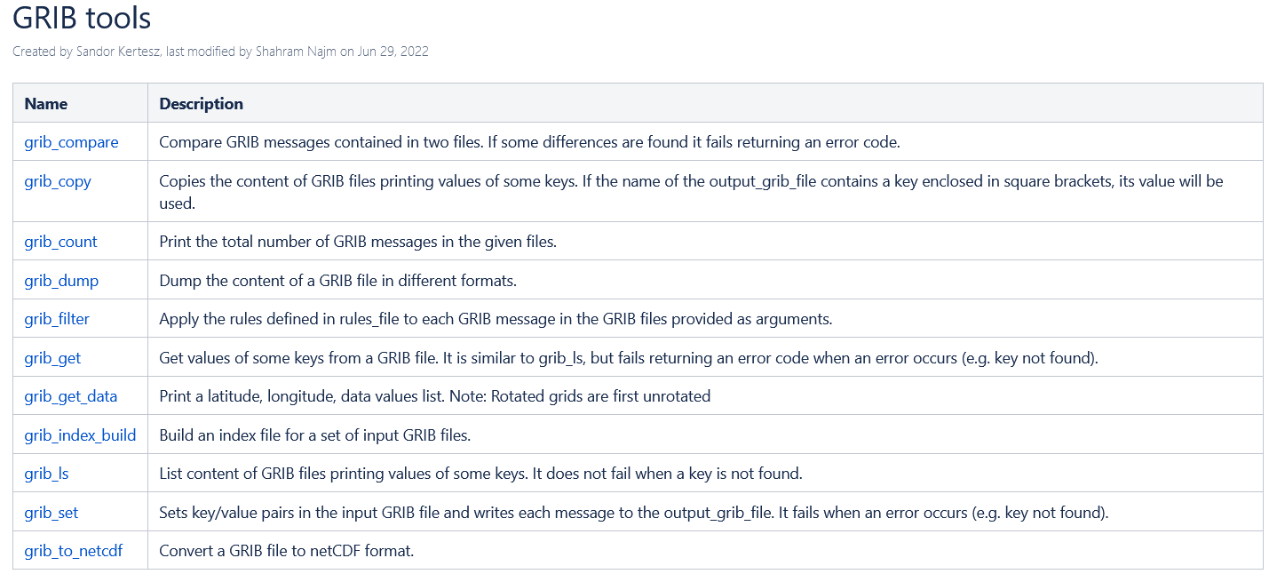
GRIB tools

Slide 29
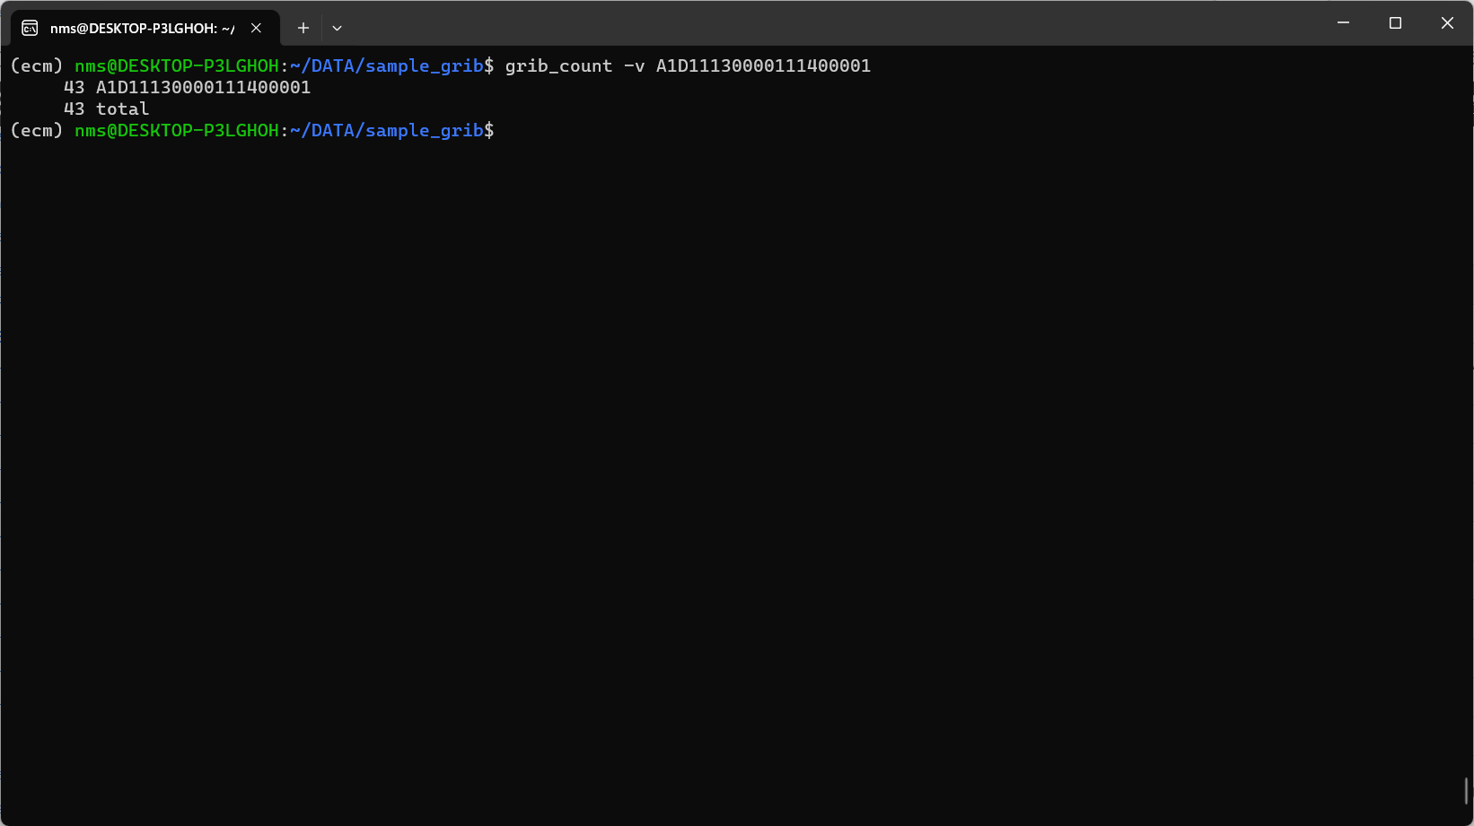
ecCodes | grib_count

Slide 30
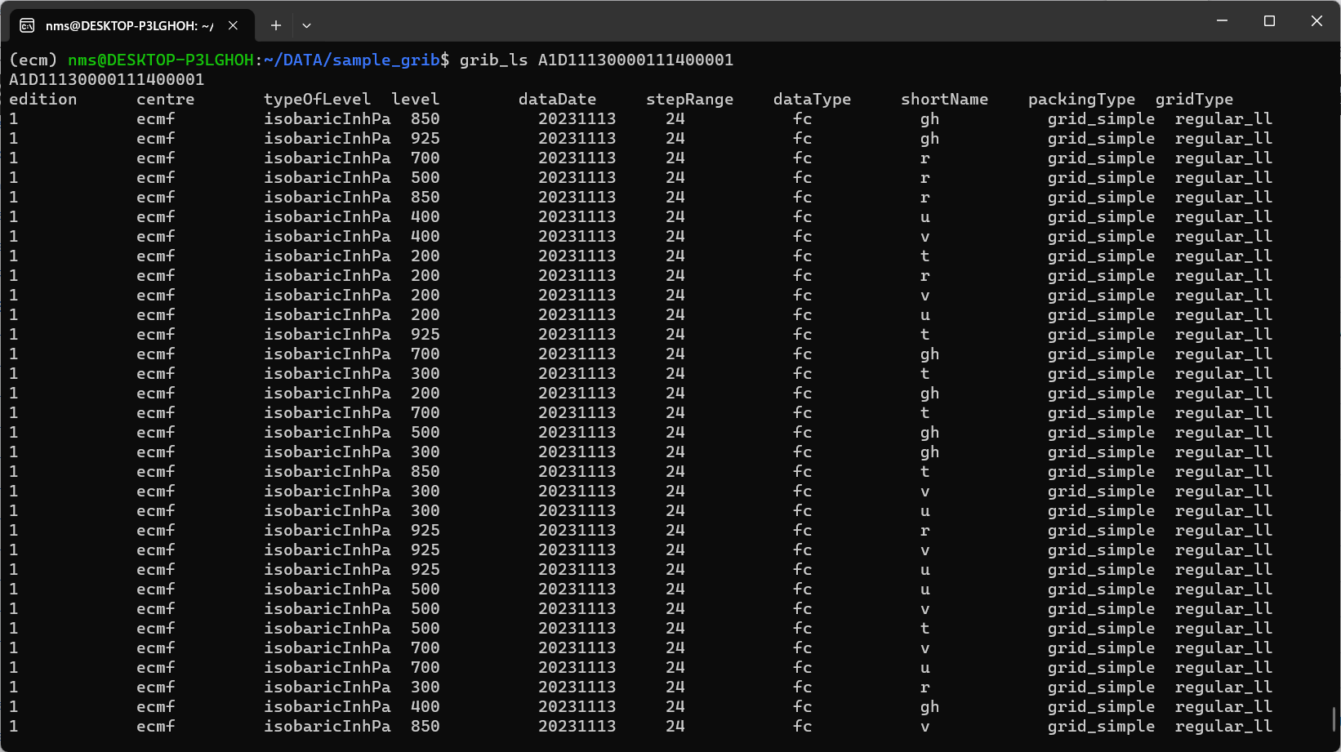
ecCodes | grib_ls

Slide 31
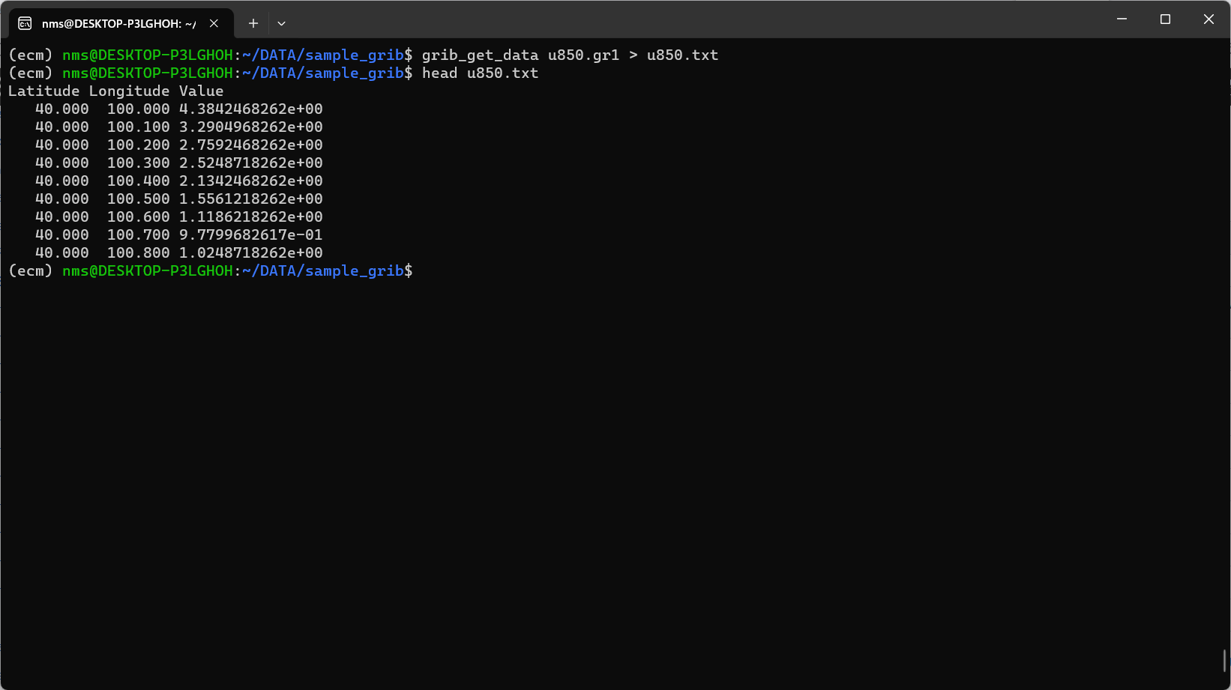
ecCodes | grib_get_data

Slide 32
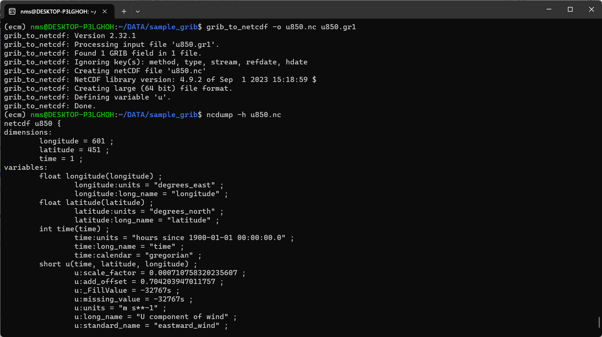
ecCodes | grib_to_netcdf

Slide 33
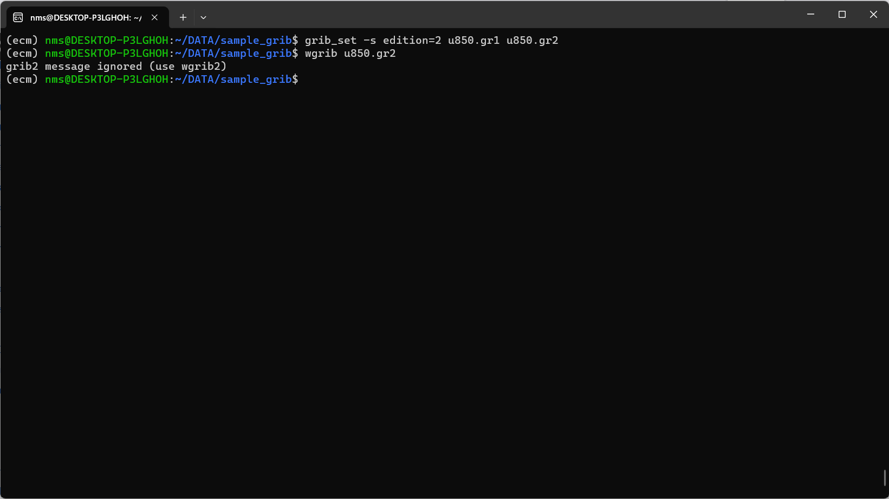
ecCodes | grib_set | Convert GRIB1 to GRIB2

Slide 34
wgrib2

Slide 35
wgrib2
wgrib2 is a processor for grib2 files. It is a utility and library for manipulating grib files
inventory and read grib2 files
create subsets
create regional subsets by cookie cutter or projections
export to ieee, text, binary, CSV, netcdf and mysql
import to ieee, text, binary, and netcdf
write of new grib2 fields
parallel processing by using threads (OpenMP)
parallel processing by flow-based programming
wgrib2 is versatile because it's command line is a simple language

Slide 36
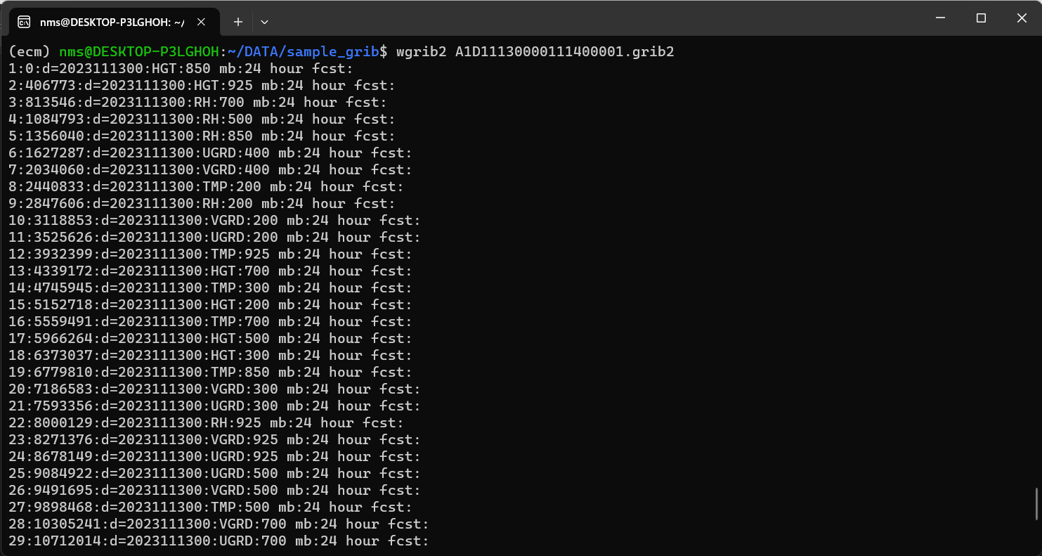
wgrib2 <file_name>
Short Inventory

Slide 37
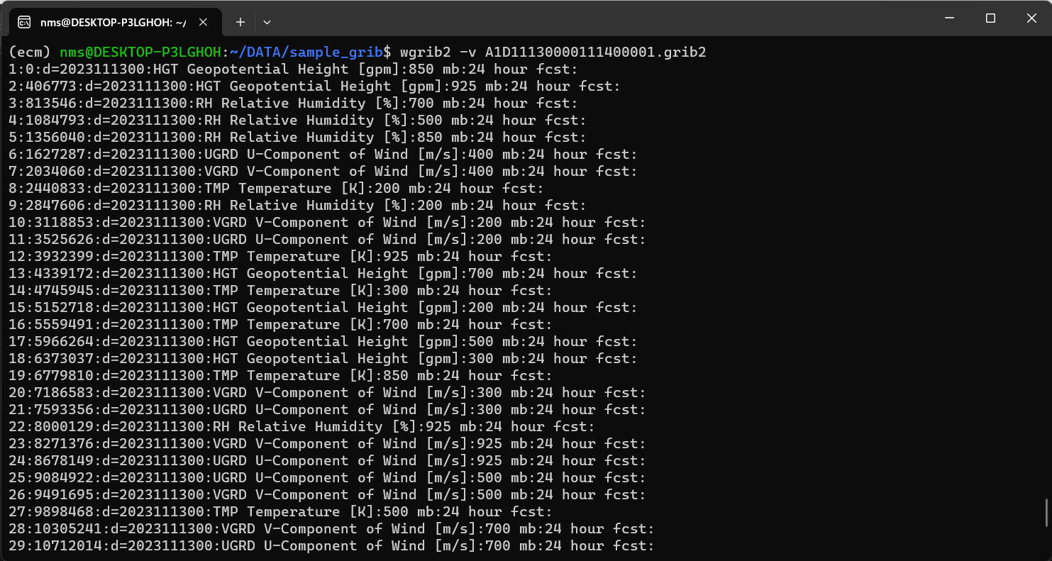
wgrib2 -v <file_name>
Verbose Inventory

Slide 38
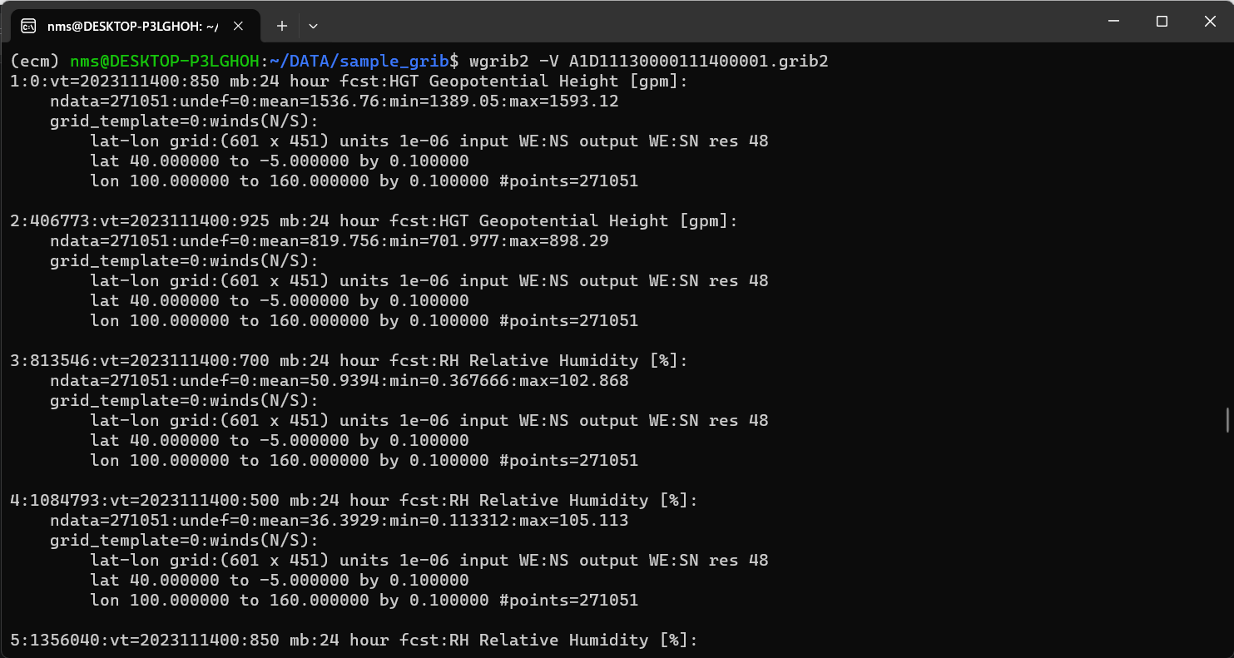
wgrib2 -V <file_name>
Verbose Description

Slide 39
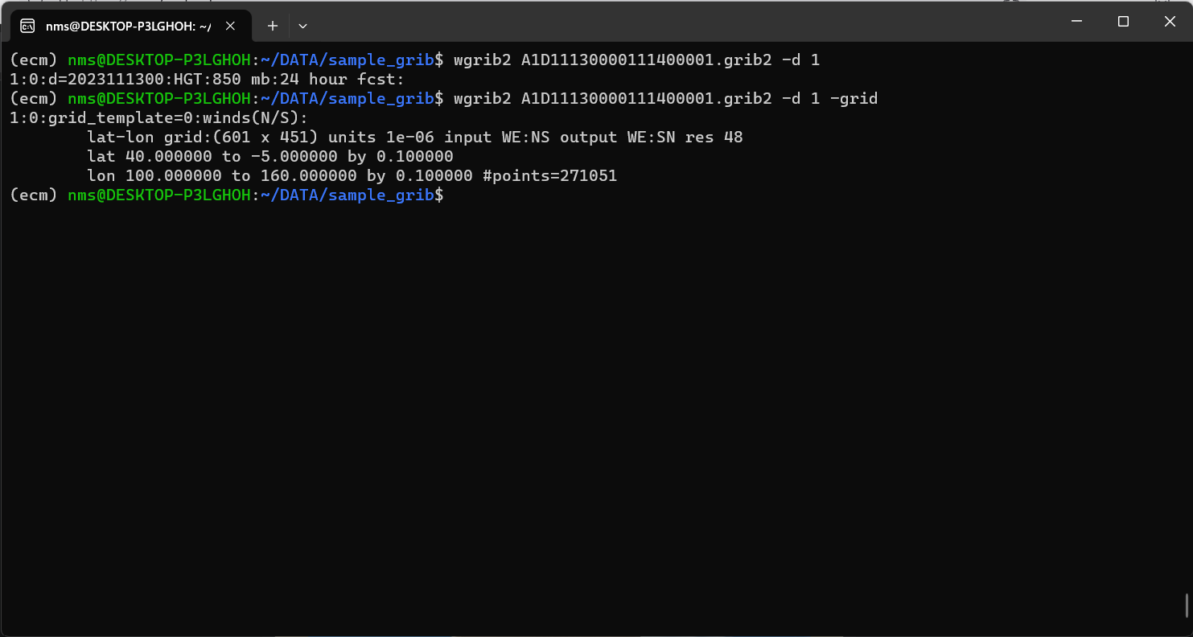
wgrib2 <file_name> -d <message_number>
Select by message number

Slide 40
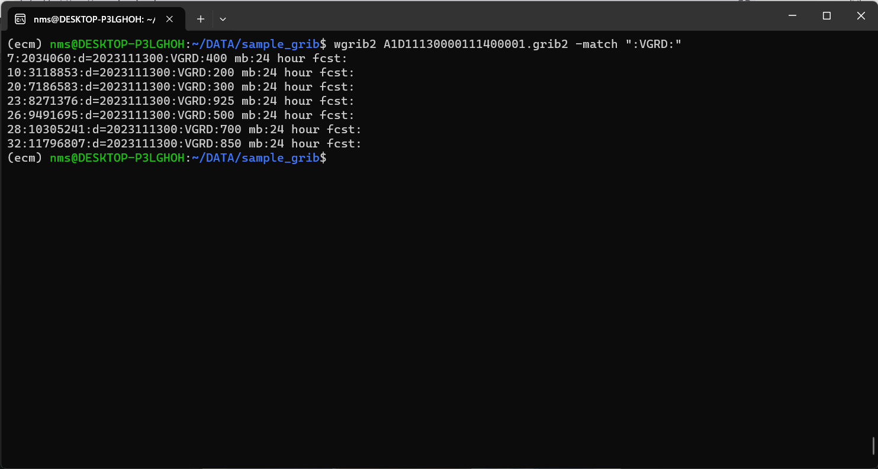
wgrib2 <file_name> -match <match_string>
Match by parameter name

Slide 41
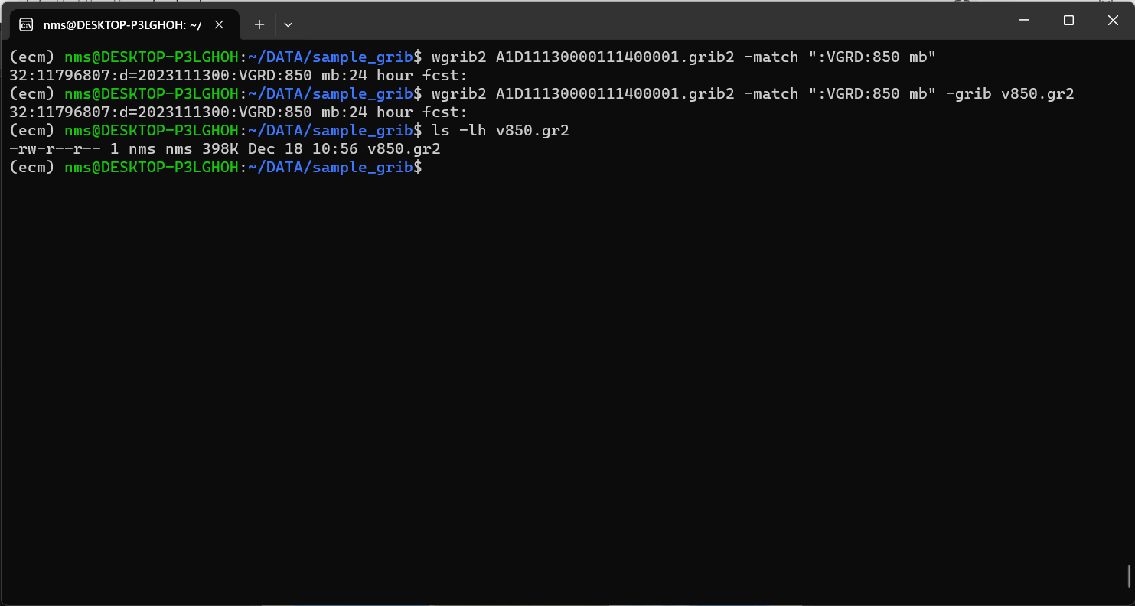
wgrib2 <file_name> -match <match_string>
Match by parameter name and level then save

Slide 42
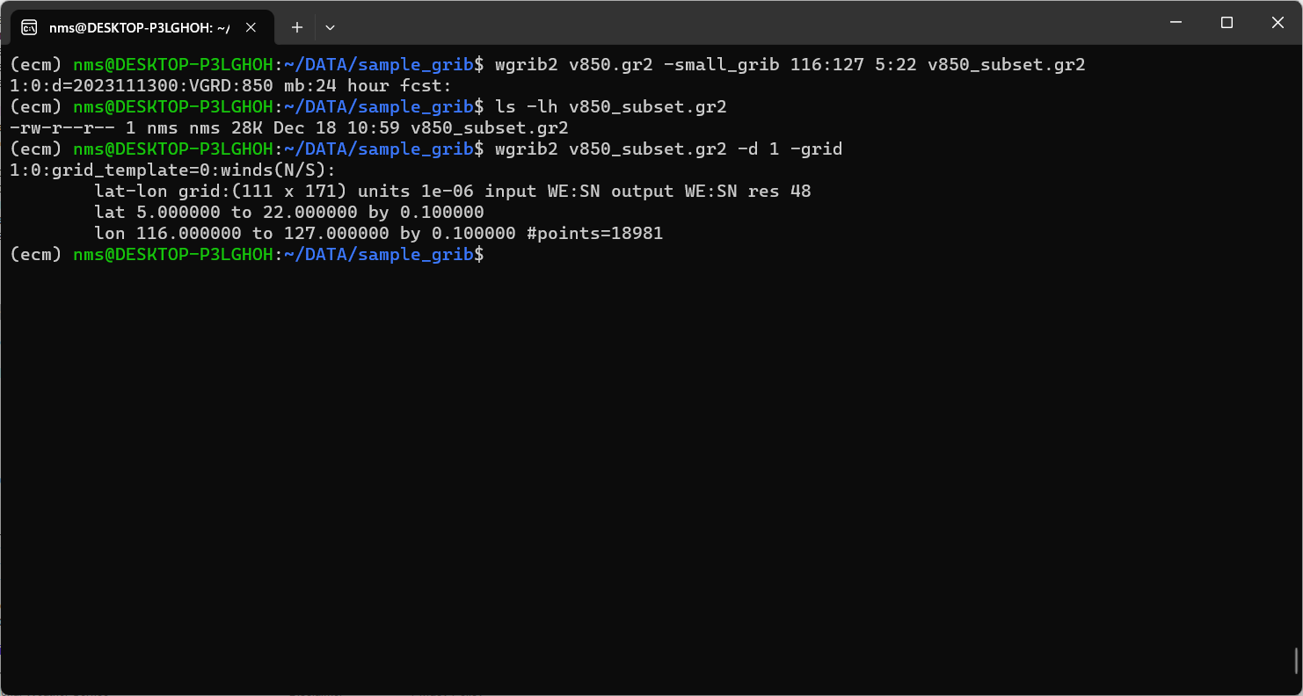
wgrib2 <file_name> -small_grib LonW:LonE LatS:LatN <output_file_name>
Sub-set by lat-lon bounds

